Slide 1
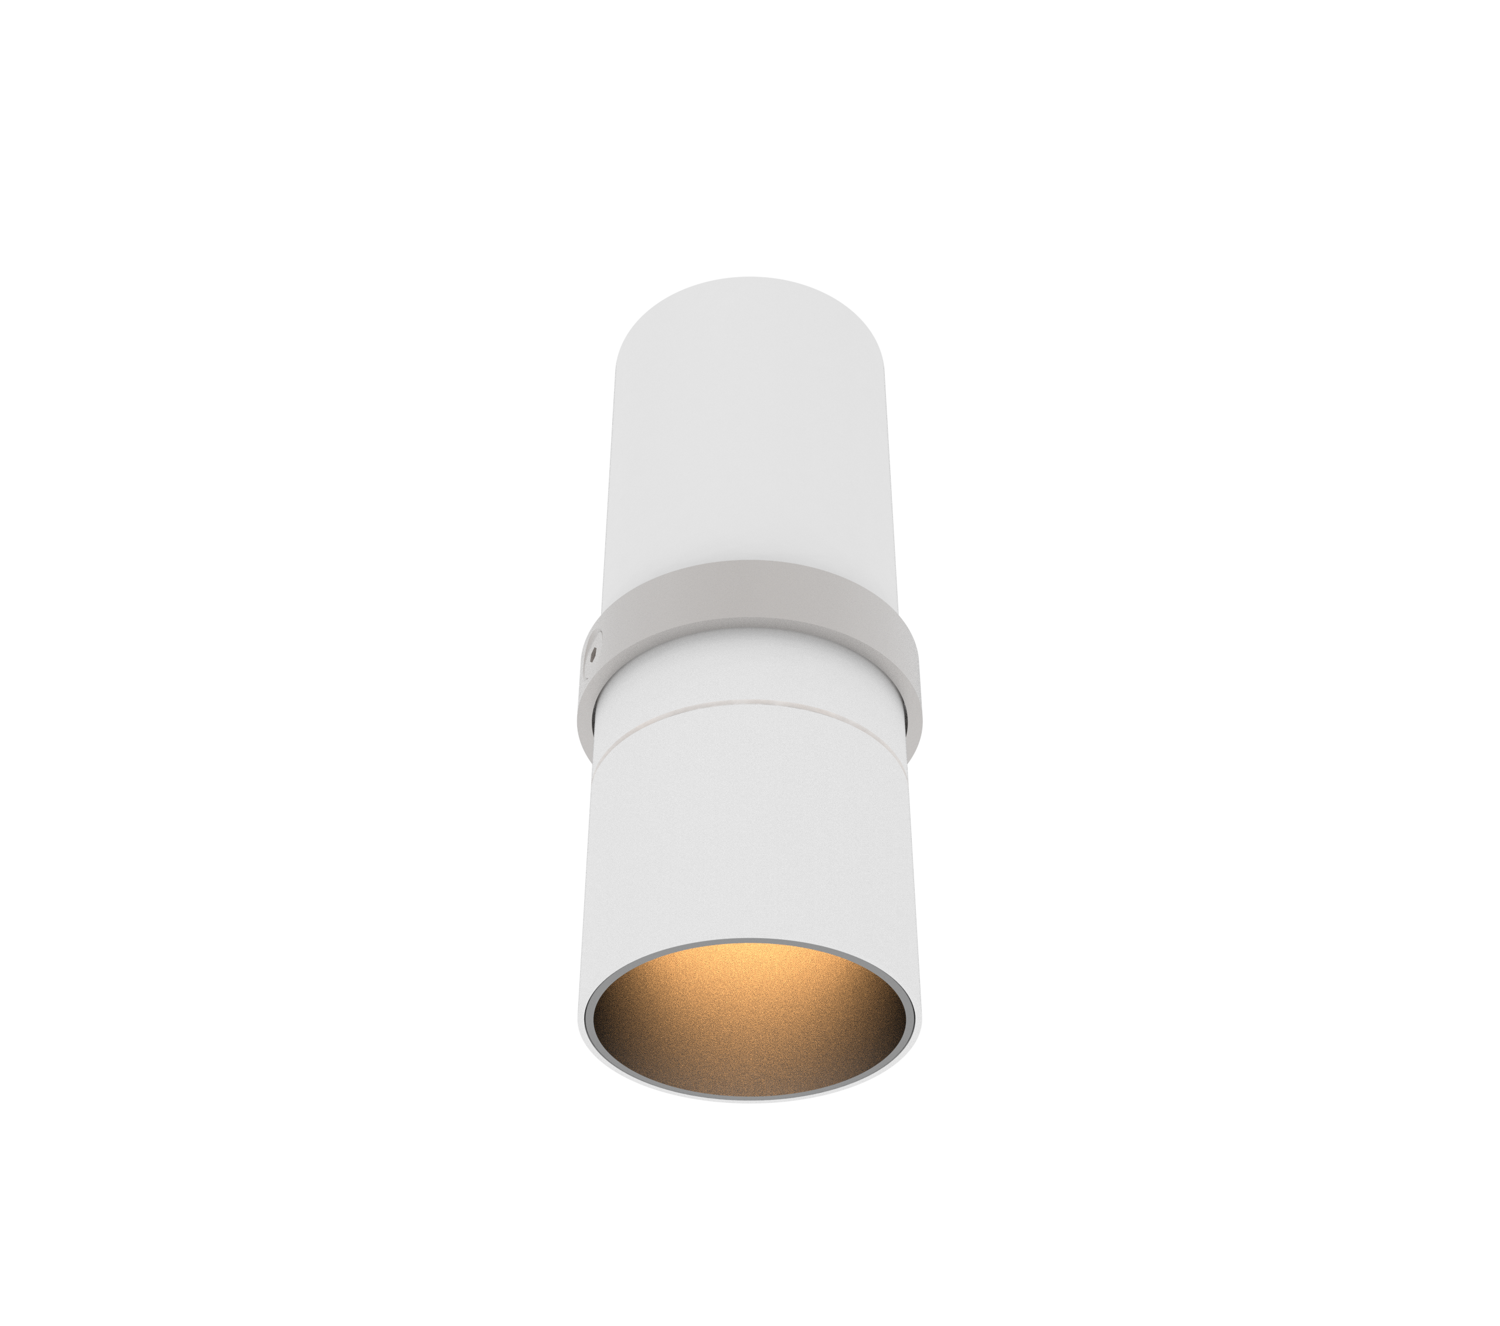
AURORE
D52
Fixed canon version
IP
20
Ta
25º

Slide 2
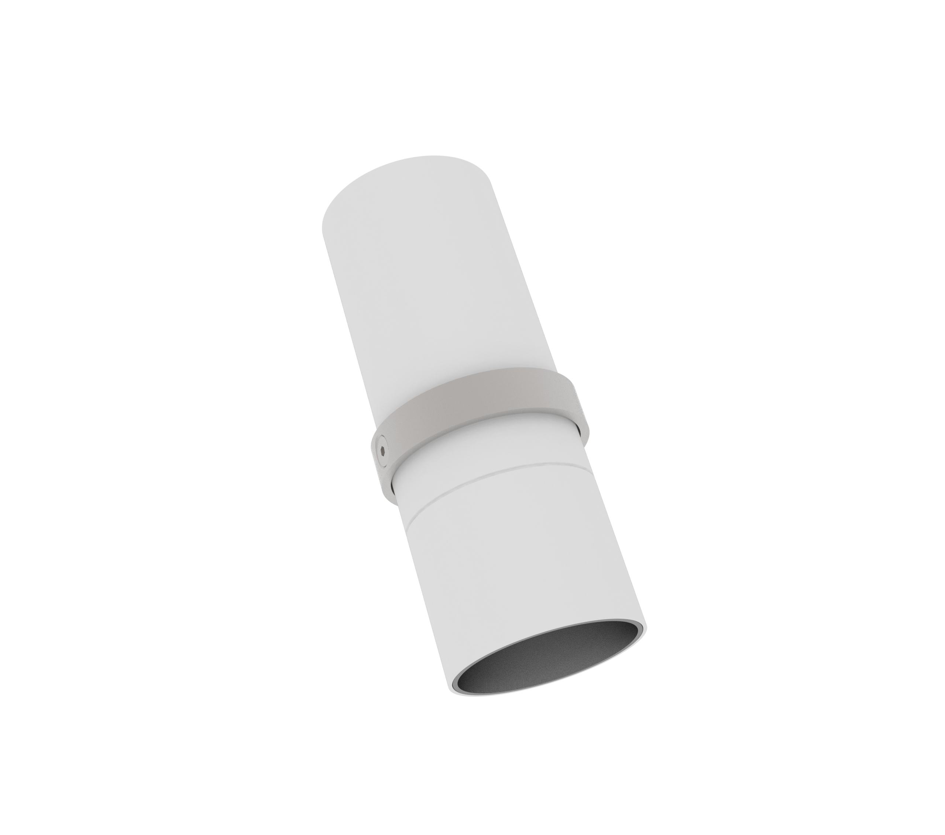
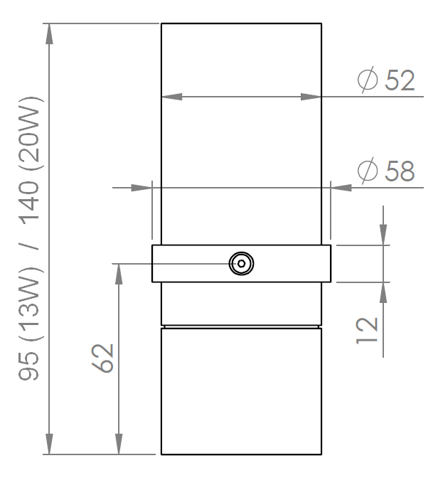
AURORE D52
Fixed canon version
Range | Highly flexible recessed ceiling downlight for general & accent cardanic lighting
Description | Low luminance Output luminous flux between 600 and 1,500Lm Rotation 360º - Adjustable tilt 30º + 30º Black finishing (other upon request)
Net weight | 0.4 kg
Installation | Installation diameter: 58mm No specific tools required
LED characteristics | 2700K - 3000K – 3500K – 4000K – 5000K MacAdam ellipse: 3 SDCM (standard version) – 2 SDCM (premium version) CRI 90 (standard version) – CRI 95, R9 > 90 (premium version) UGR < 15
Optical beam | 7° - 12º - 15º - 20º - 25º - 30º - 35º - Elliptical Special filter, honey comb grid upon request
Separate power supply | 350mA to 1400mA constant current driver according to version Dimmable driver upon request
LED power | 6W to 25W
Connection | Delivered with 0.50m cable
Use limitations | The product must be installed into a ventilated area. Any use with an ambient temperature higher than the specified ambient temperature (Ta) would lead to a more rapid mortality of the product and the withdrawal of our guarantees. The drivers, if not delivered by LOuss, must be approved before use.
Warranty | Life span: L80B10 at 50,000 hours (80% remaining flux) at 25°C ambient temperature. 3-year parts and labour warranty. The warranty does not apply to products that have been opened, modified or repaired and does not cover the effects of a wrong connection, careless, abusive handling, overvoltage, lighting injury, as well as the normal wear of the product. All products are electrically tested and received a functional burn-in.
All the connections have to be made before powering up,
otherwise the luminaires could be seriously damaged.
Last update : 23/10/2019
Firalux & LOuss brands
SARL, Capital 40 000€
RCS DIJON B 503 367 245
TVA/VAT n°: FR24 503 367 245
APE 4676Z
Tel. : +33 380 48 65 68
contact@louss.fr
www.louss.fr
Best group
Siège social / Head Office
PA Les Terres d’Or
Route de Saint Philibert
21220 Gevrey Chambertin - FRANCE

